Slide 1

Detailed Documentation for DMA project
Madonna Magdy Moussa

Slide 2

Experiment 1:
Compare transfer time of 1024 bytes (Memory To memory transfer) with and without DMA

Slide 3
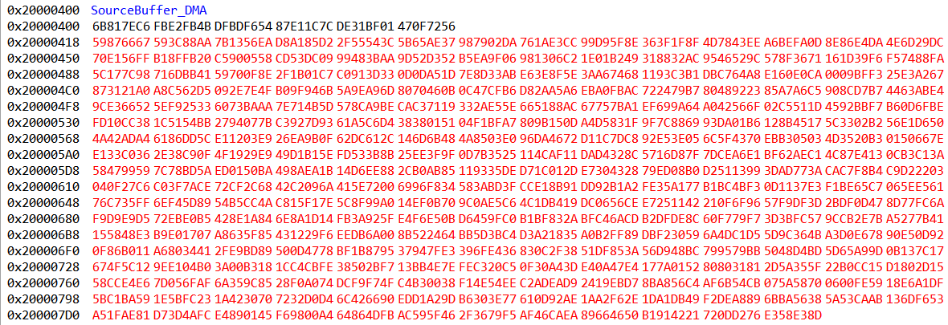
Source Buffer
&SourceBuffer_DMA[0]=0x20000400 &SourceBuffer_DMA[1023]=0x200007FF
Transfer Size= 0x200007FF - 0x20000400 + 1 = 0x400 = 1024 bytes

Slide 4
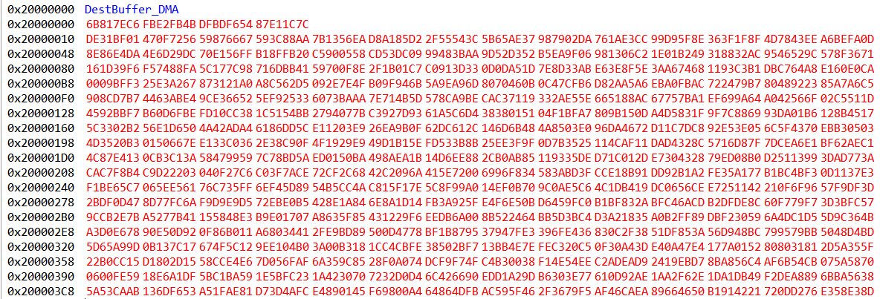
Destination Buffer after the data is transferred
&DestBuffer_DMA[0]=0x20000000 &DestBuffer_DMA[1023]=0x200003FF
Transfer Size= 0x200003FF - 0x20000000 + 1 = 0x400 = 1024 bytes

Slide 5
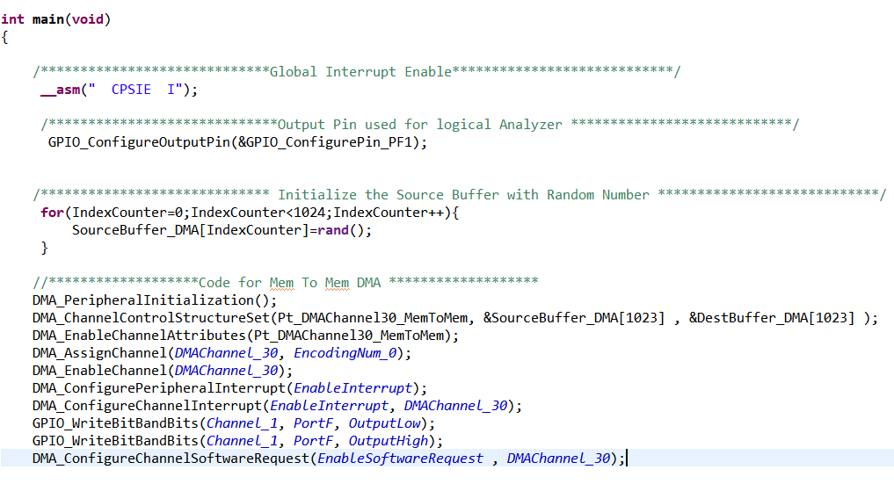
DMA Code
Setting output pin before sending the request to DMA controller.
DMA controller begins transfer when the request is sent
Output pin is connected to logical analyzer

Slide 6
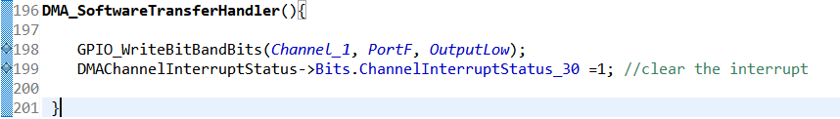
DMA Code
Setting Output Pin to low in the DMA transfer Handler.

Slide 7
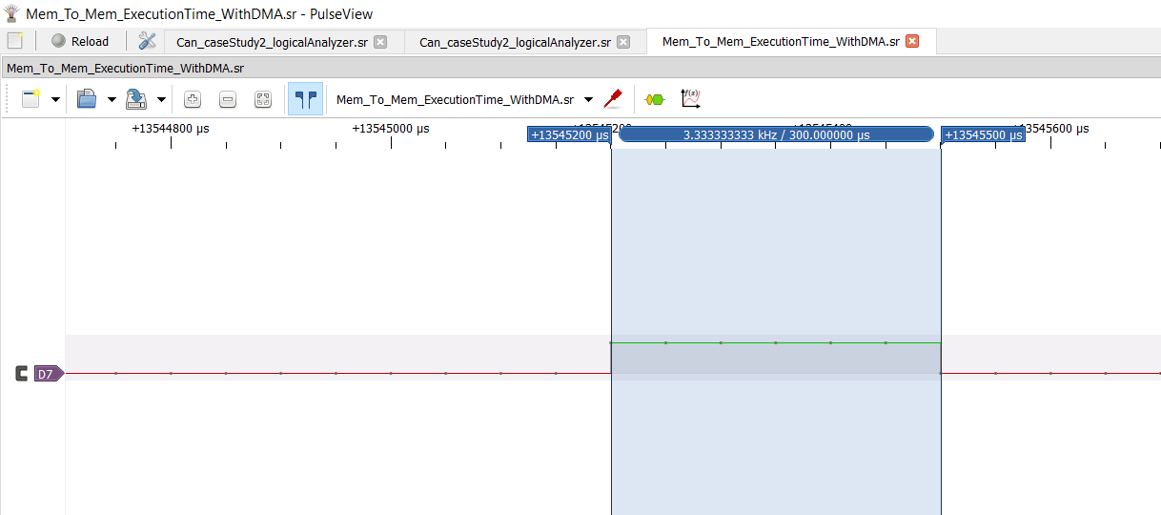
Transfer Time using DMA

Slide 8
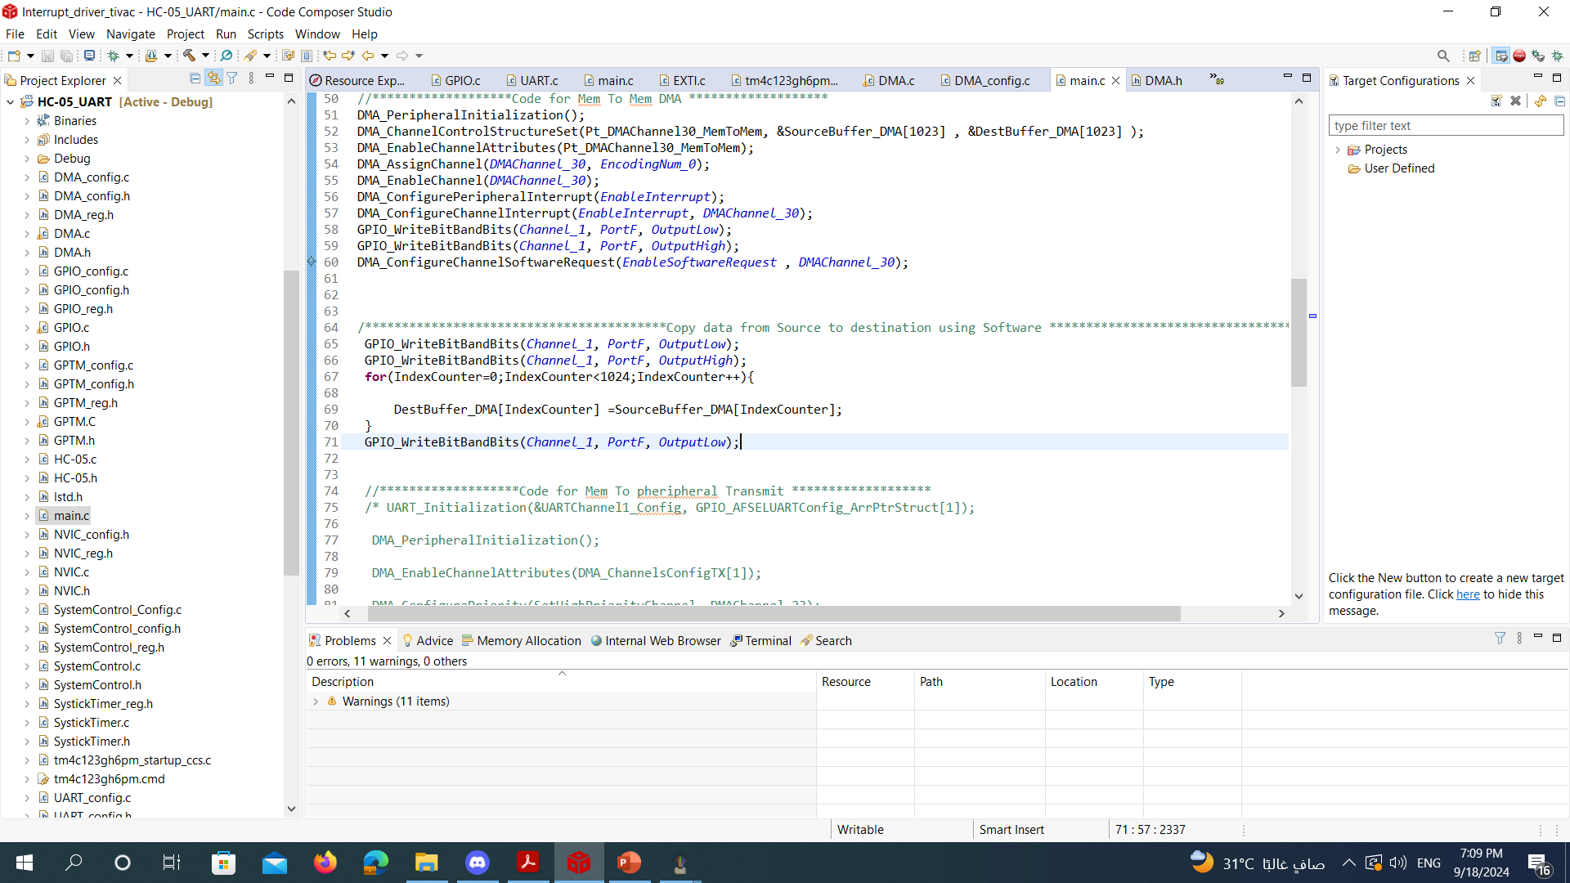
Code Without using DMA

Slide 9
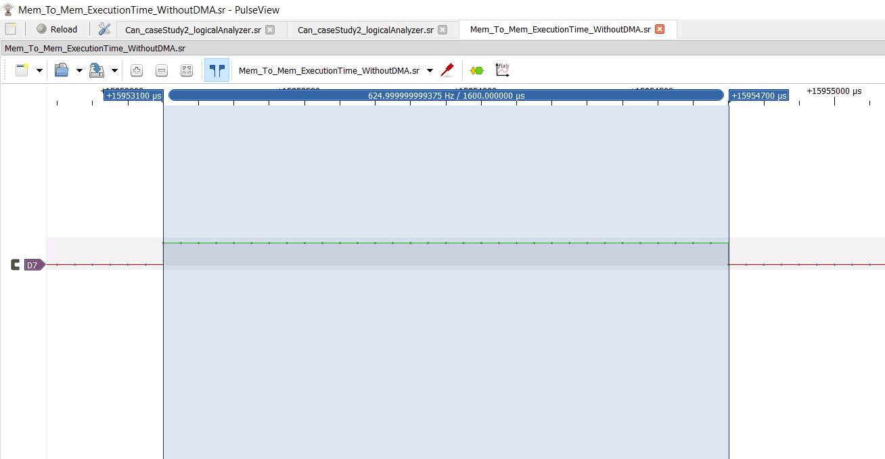
Transfer Time without using DMA

Slide 10
Debugging for DMA

Slide 11
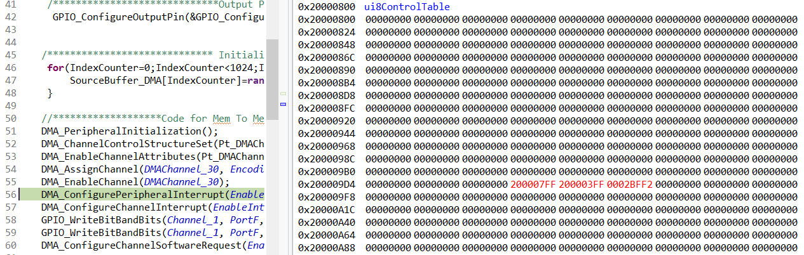
Source buffer End pointer
Destination buffer End pointer

Slide 12
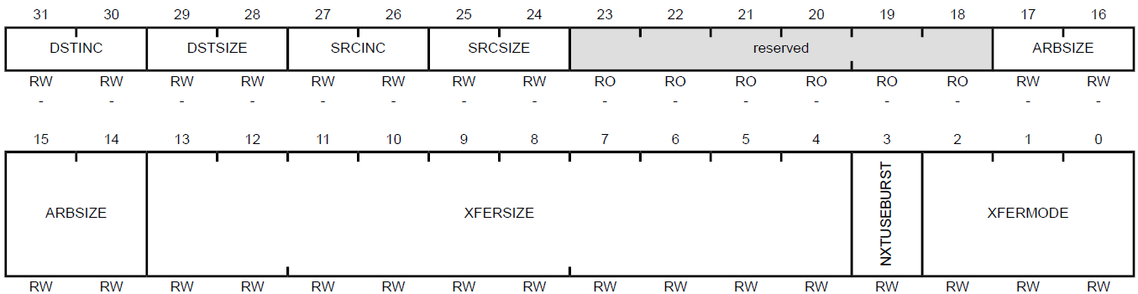
Control word

Slide 13
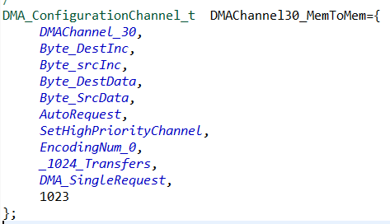
Control word before transferring data is 0x0002BFF2
-Transfer mode (XFERMODE) is Auto request =0x2
-Transfer size (XFERSIZE) is 1024-1 (this field is 1 less than the number to transfer → hardware requirement).
-Arbitration size= 1024 transfers=0xA.
-Source size (SRCSIZE)= 1 byte =0x0.
-Source increment (SRCINC)= 1 byte =0x0.
-Destination size (SRCSIZE)= 1 byte =0x0.
-Destination increment (DSTINC)= 1 byte =0x0.

Slide 14
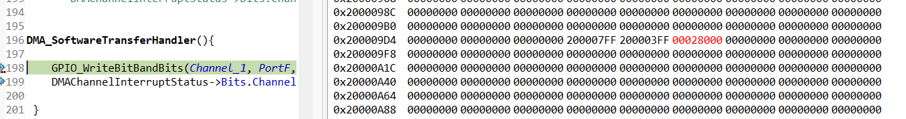
Control word after transferring data is 0x00028000
-Field of the transfer mode is 0x00→ stop mode
-Field of the transfer size becomes 0x0 → all items are transferred

Slide 15

Code Link for experiment 1:
https://github.com/madonnamagdymoussa/DMA-Direct-Memory-Access/tree/main/ComparisonCode_WithAndWithoutDMA_MemToMem/HC-05_UART

Slide 16

Experiment 2:
-Two TIVA C boards are communicating with each other through UART. Transmitting 1024 bytes with DMA using burst request.
-In each burst request (experiment), vary the transfer size as follows: 16, 8, 4, 2, and a single request (transfer size=1) , compare the transfer time and CPU load for each transfer size in order to complete a total transfer of 1024 bytes.

Slide 17
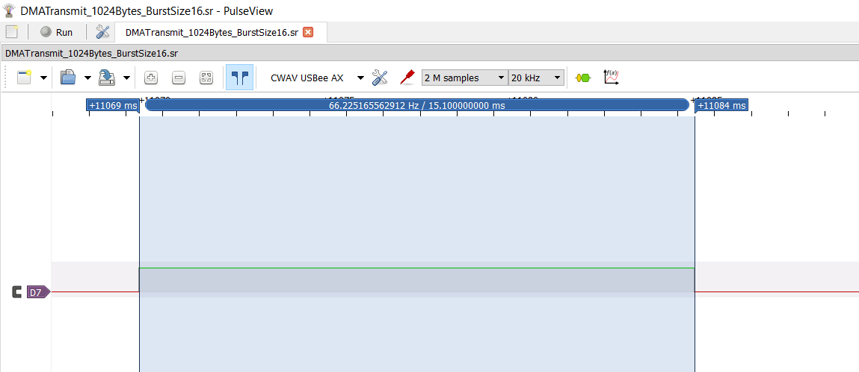
Transfer Time (1024 bytes) Burst Request → burst size = 16 bytes

Slide 18
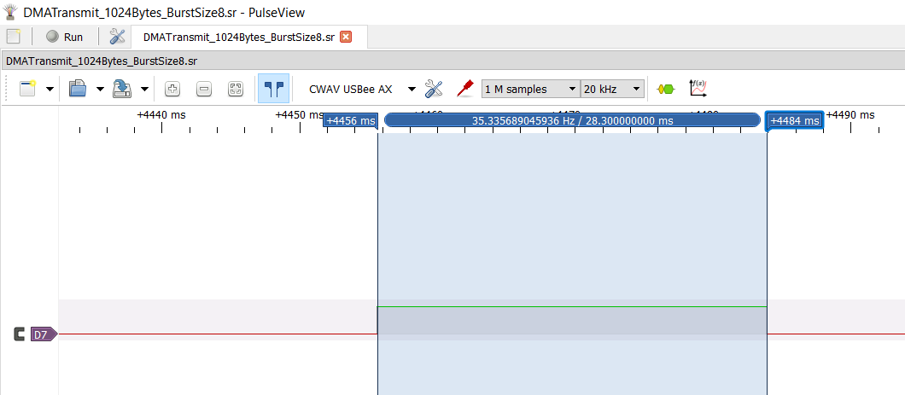
Transfer Time (1024 bytes) Burst Request → burst size = 8 bytes

Slide 19
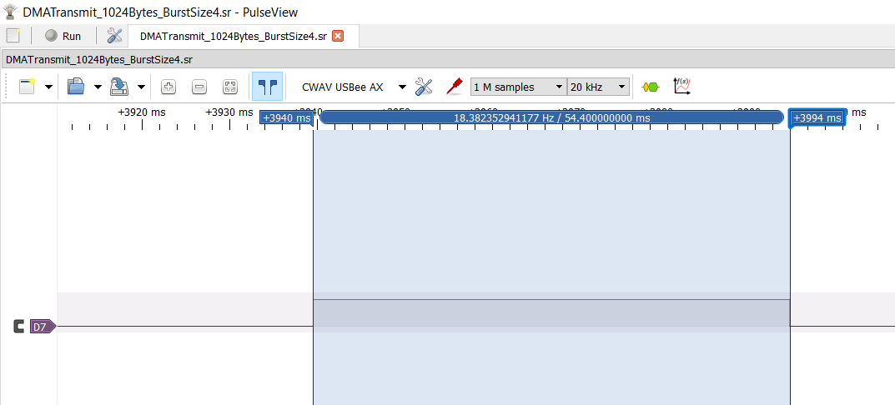
Transfer Time (1024 bytes) Burst Request → burst size = 4 bytes

Slide 20
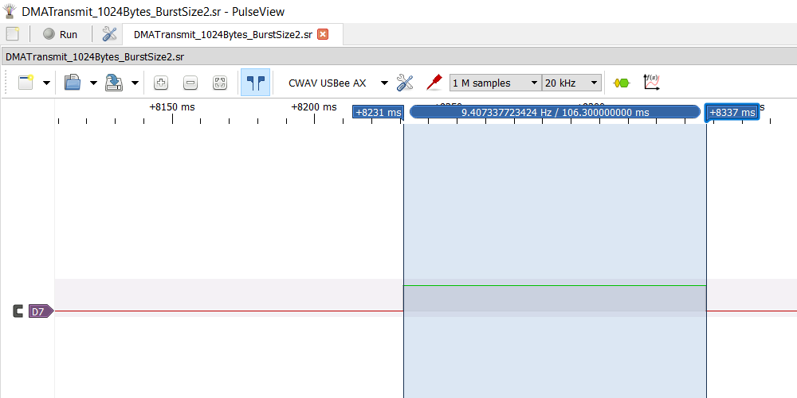
Transfer Time (1024 bytes) Burst Request → burst size = 2 bytes

Slide 21
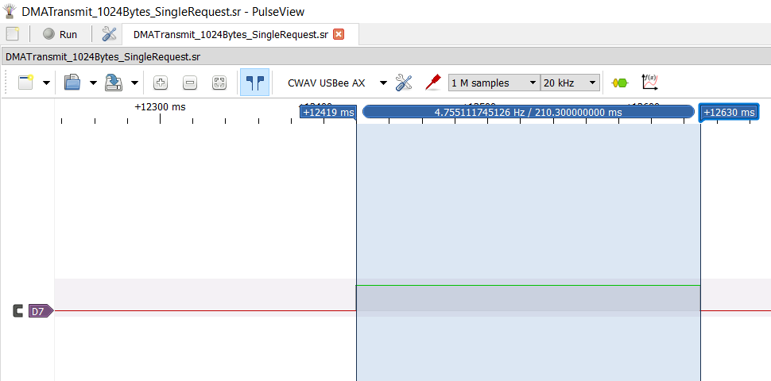
Transfer Time (1024 bytes) Single Request → Transfer size = 1 byte

Slide 22
Summary Table for experiment 2: Transfer Time DMA for each request size
Request Size
Total time to transfer 1024 bytes
v
Burst request – transfer size 16 bytes
15.1 milli seconds
Burst request – transfer size 8 bytes
28.3 milli seconds
Burst request – transfer size 4 bytes
54.4 milli seconds
Burst request – transfer size 2 bytes
106.3 milli seconds
Single request – transfer size 1 bytes
210.3 milli seconds

Slide 23

Measure CPU load

Slide 24
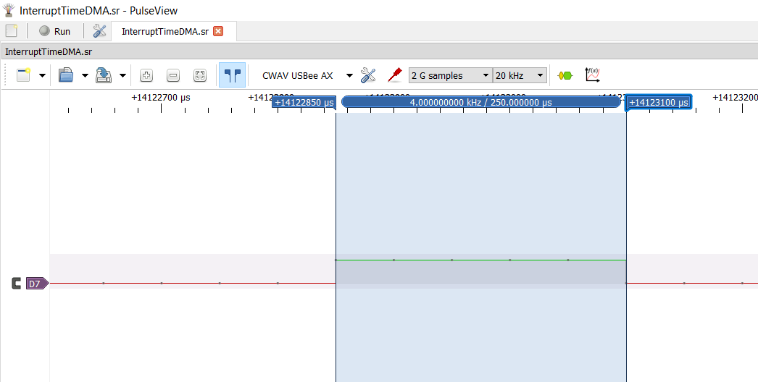
Interrupt Execution Time for DMA

Slide 25
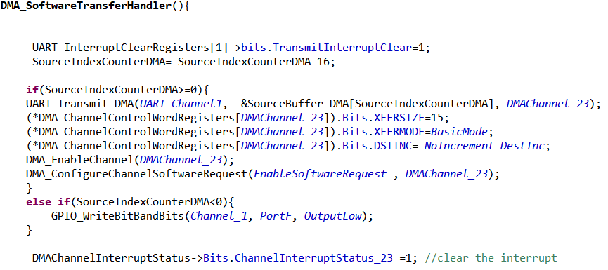
DMA handler

Slide 26
Measuring CPU Load in case of 16 bytes burst request
-In Case of 16 bytes burst request the DMA handler is executed 64 times in order to transfer a total of 1024 bytes.
1024/16=64
-64*200 micro sec= 16 milli second
-

Slide 27
Code Link for experiment 2:
https://github.com/madonnamagdymoussa/DMA-Direct-Memory-Access/tree/main/TransmitDMA_UART_1024Bytes_BurstSize16bytes

Slide 28

Experiment 3:
-Measure the transfer time of transmitting 1024 bytes using polling and interrupt method.
-Compare the time taken by polling and interrupt method with the time taken using DMA

Slide 30

Experiment 4:
Two TIVA C boards are communicating with each other through UART.
1-Compare the transfer time of sending 1024 bytes with Polling and DMA method.
2-Compare the CPU load in the two methods.
3-Measure the effect of

Slide 32
Code Link for experiment 4:
https://github.com/madonnamagdymoussa/DMA-Direct-Memory-Access/tree/main/TwoTiva_OneTransmitPeriphToPher_OneRecievePingPong

